Slide 1

South Africa’s Digital Competitiveness
vs
Other BRICS Countries
Name & Surname | Chipo Jokonya
Contact detail | chipojj@gmail.com

Slide 2
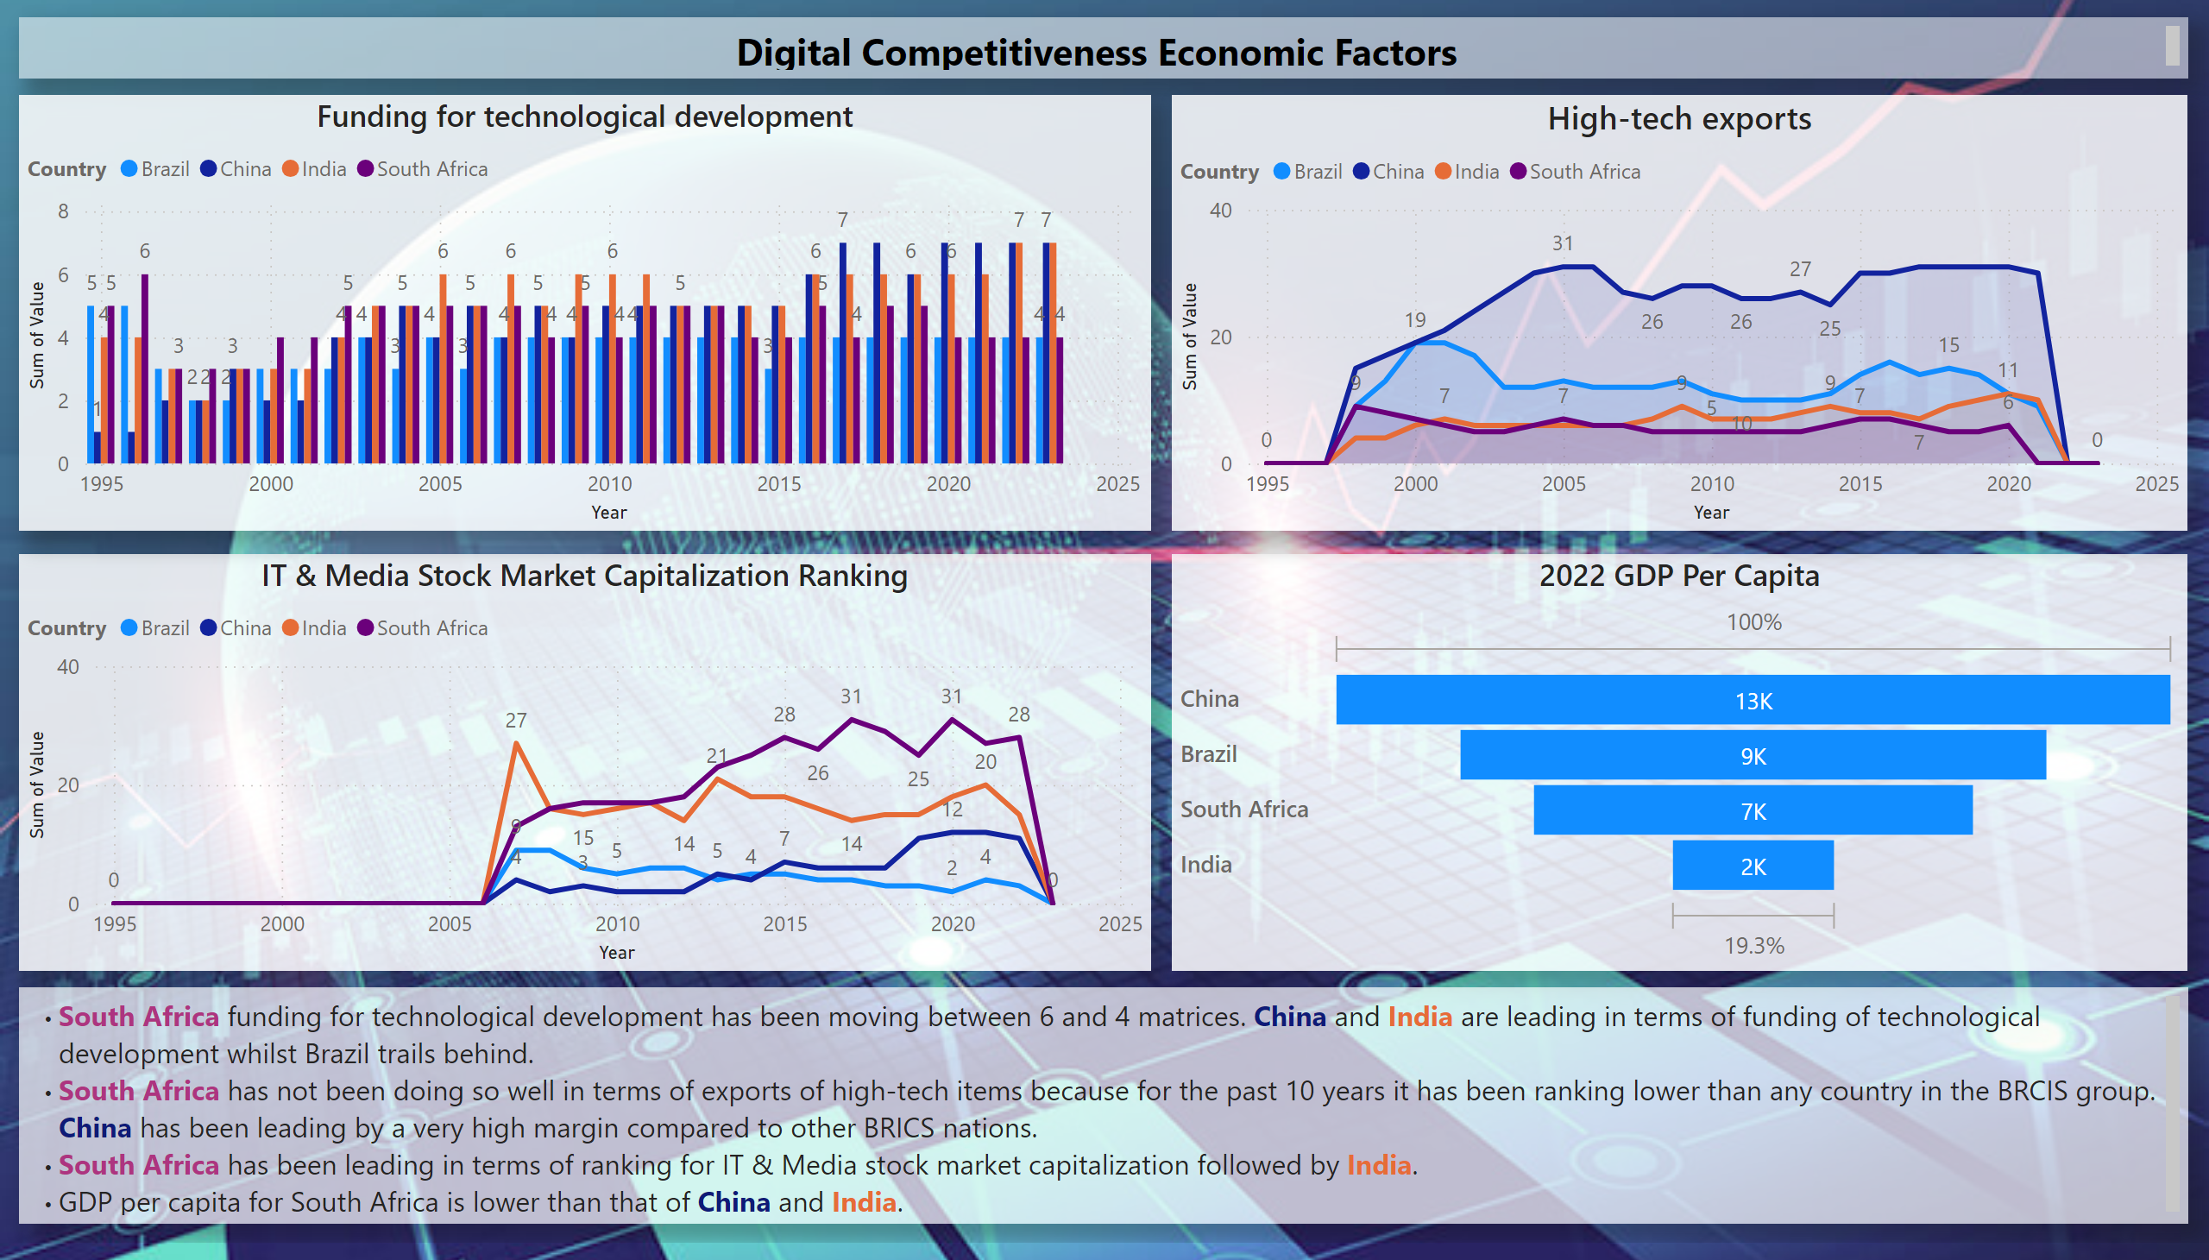
Econmic

Slide 3
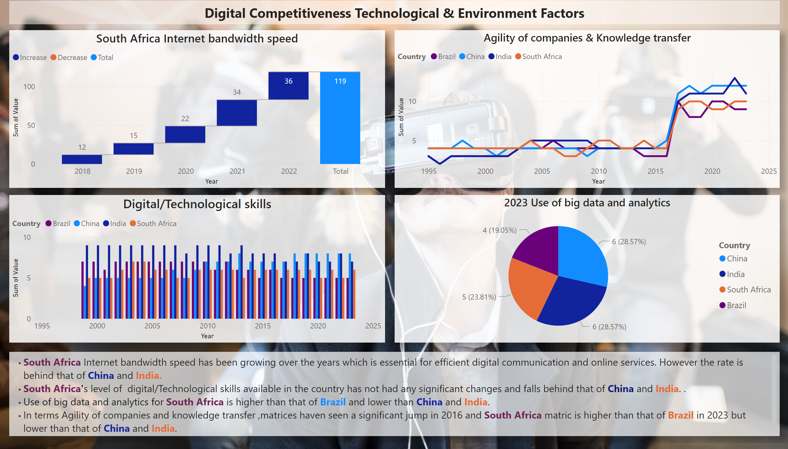
Technological & Envirinment

Slide 4
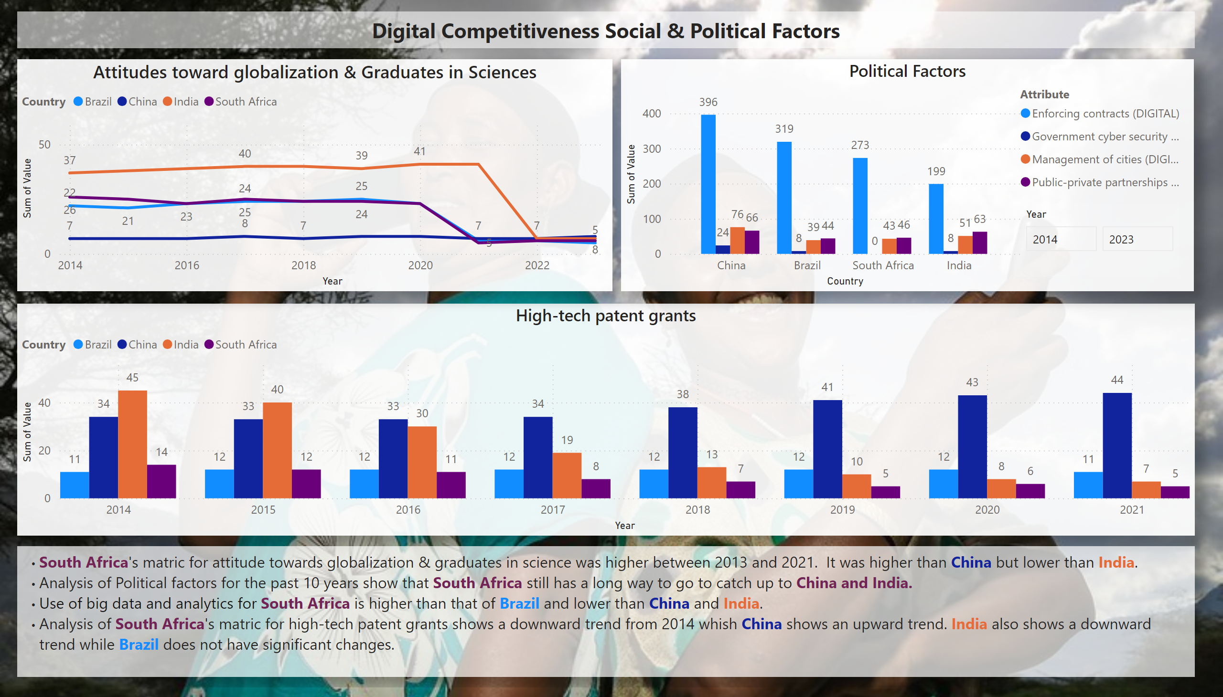
Social and Political Factors

Slide 5
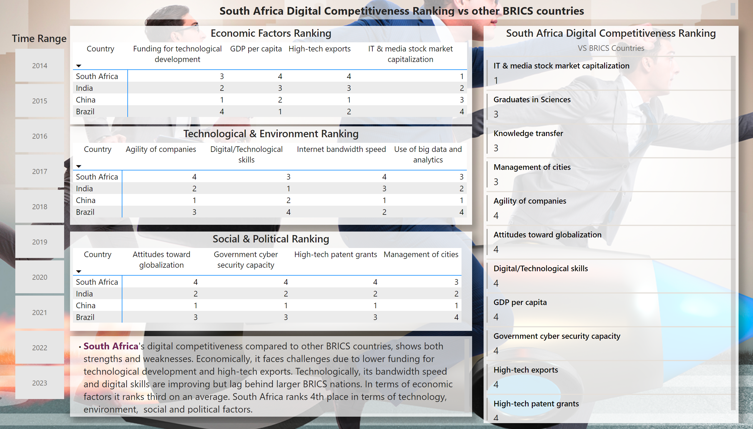
Overal Digital Competitiviness
Notes:
Economic Factors Ranking
No alt text provided
Time Range
No alt text provided
Technological & Environment Ranking
No alt text provided
Social & Political Ranking
No alt text provided
South Africa Digital Competitiveness Ranking
No alt text provided
textbox
No alt text provided
textbox
No alt text provided

